Slide 1

Introduction to ML Models
By Epoch Team, IIT Hyderabad

Slide 2
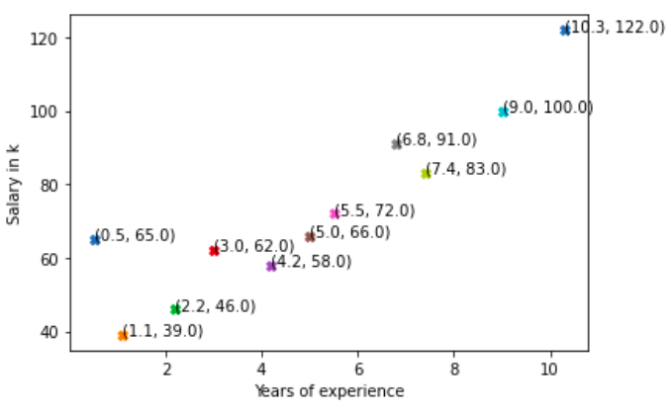
Let’s start with an example…
Given: Data of salary of some persons with their years of experience
Goal: Predict the salary of a person with 8 years of experience.
Notes:
How machine learning can help us with this?

Slide 3
Recap time!!!
Supervised Learning vs Unsupervised Learning
Supervised learning trains a model on known input and output data so that it can predict future outputs whereas unsupervised learning finds hidden patterns or intrinsic structures in input data.
Or in other words, supervised learning make predictions based on labeled training data & unsupervised learning itself identifies relationships between the unlabeled training data.
Notes:
Think of how an experienced person will do that. She will try to find a relation between years of experience and salary. And apply that relation to predict the salary of person with some other years of experience. That’s exactly what ML will do (much more better than a person)
It can even predict that India will win today’s match.

Slide 4
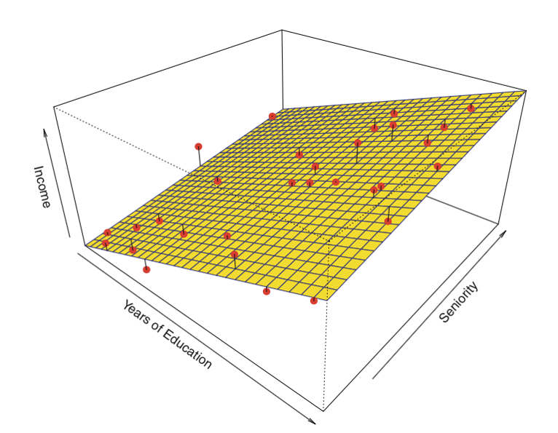
Linear Regression!!? What is it?
It is a supervised learning algorithm that assumes a linear relationship between the dependent variable and the independent variable.
We will try to fit a line (hyperplane in case of multidimensional features) that will best map the training data to its label.

Slide 5
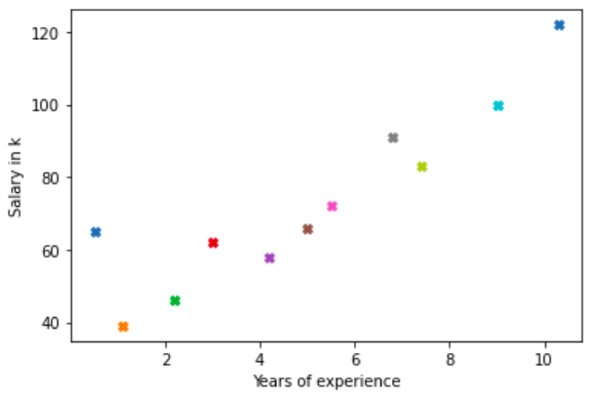

Which line do you think is the best fit line?
1
3
2
Notes:
Why line 3 is best fit line? Cause it is closest to maximum actual values.
If you will try to reduce just one gap, it may happen that some other gap is increased, so instead, you should try to reduce the sum of these gaps.

Slide 6
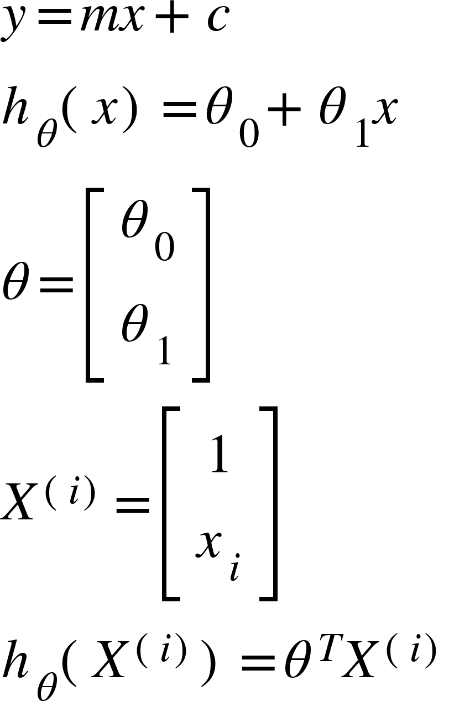
Finding the best-fit line or Hyperplane

Slide 7
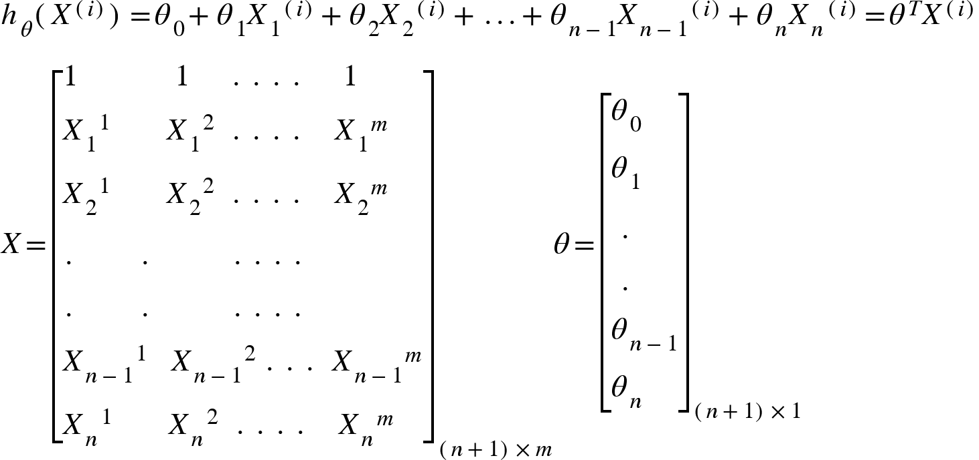
Multiple features => More Math :/
In case of multiple number of features, it can be written as:

Slide 8
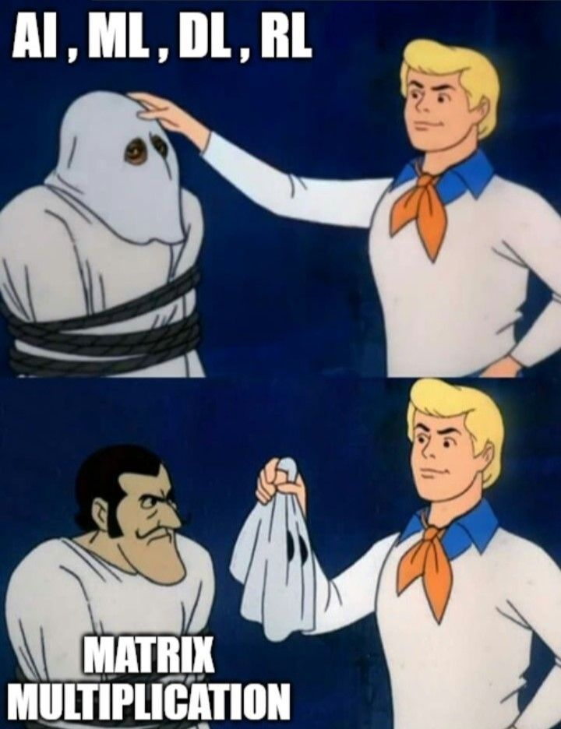
Matrix Multiplication - The Real Dad!! :)

Slide 9
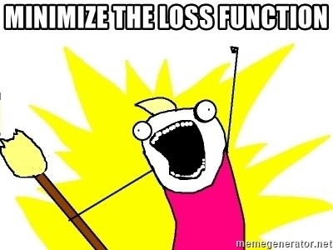
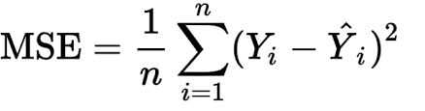
Loss function - Meet our old friend!!
Loss function predicts the deviation of the predicted outcome from the actual result. It measures how well the machine learning algorithm models the training dataset.
We convert the machine learning problem into an optimization problem, by defining the loss function and then gradually optimizing the algorithm so that the loss function is minimized.
One of the common loss functions is mean squared error (MSE).
Notes:
Remember this slide from session 1 - A Glimpse into the world of AI?

Slide 10
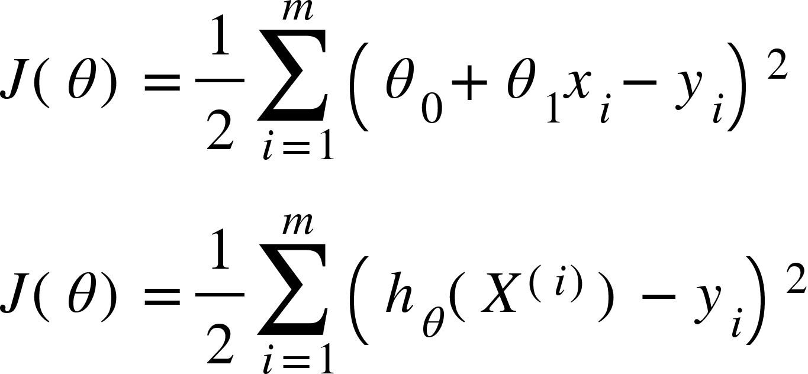
Loss function in Linear Regression
More or less…
This is the difference between predicted values by the line/hyperplane and actual values.
Goal:
Find 𝚹 which minimizes the loss function

Slide 11
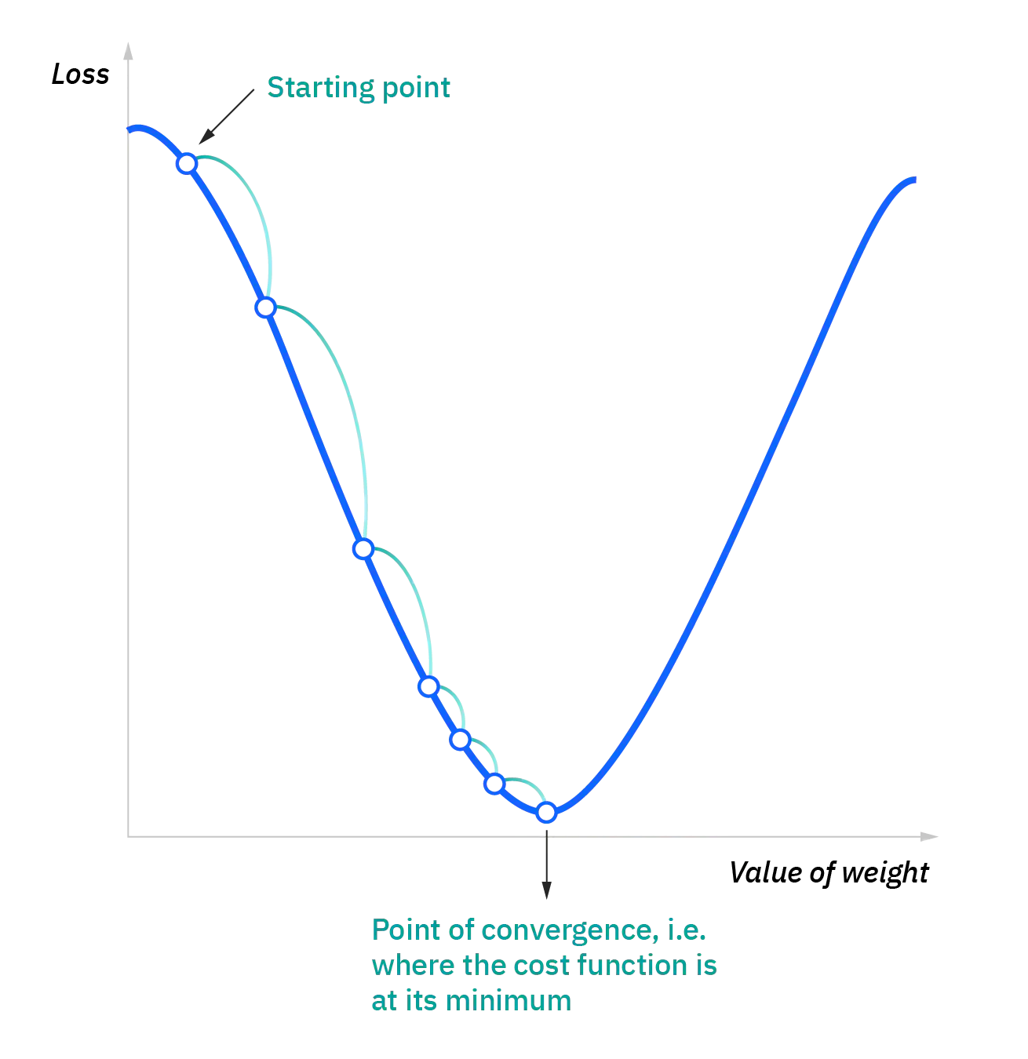
Gradient Descent
It is an optimization algorithm/technique commonly used to train machine learning models.
Key Idea: Take the fastest route towards the minimum of the function from current point to converge fast.
We take repeated steps in the opposite direction of the gradient of the function as that is the steepest descent possible
Notes:
We look in every direction from where we are standing, and then move in a direction that will descend us the fastest.

Slide 12
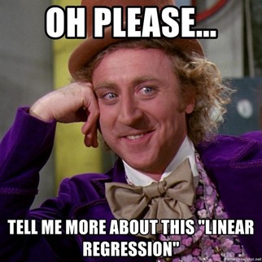
Audience be like:

Slide 13
Get this clear! What do we do in Gradient Descent??
Initialize 𝚹 to any value.
Compute the loss function at that value of 𝚹.
Update 𝚹 until the loss function reaches very close to its minimum.
Notes:
These steps are similar to finding square root of a number by binary search or such methods. We guessed some value and we keep updating it until its square is very close to the number.

Slide 14
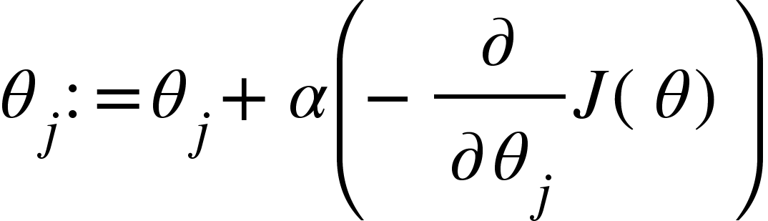
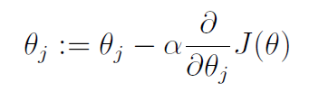
How to update 𝚹 ???
To update 𝚹, move in the opposite direction of the slope.
α decides the length of the steps. It is called learning rate.
This determines the direction of the step.
Notes:
Updating theta is the key step. It is different for different algorithms.

Slide 15
More about the Learning Rate - ⍺
Parameter you have to choose on your own.
Parameter tuning: Process of choosing optimal ⍺, which will:
Reduce computing time
Increase accuracy of model
Notes:
We have to use hit and trial, hook and crook for this. There is no generalized optimum value for it.

Slide 16
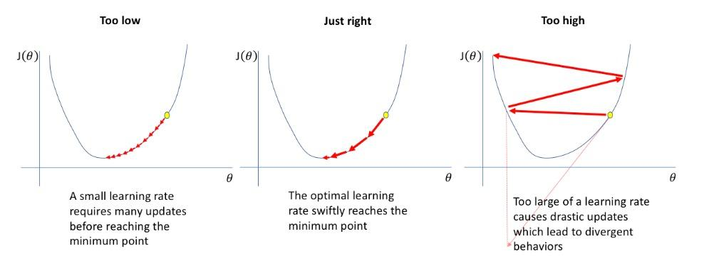
How does the value of ⍺ matter?

Slide 17
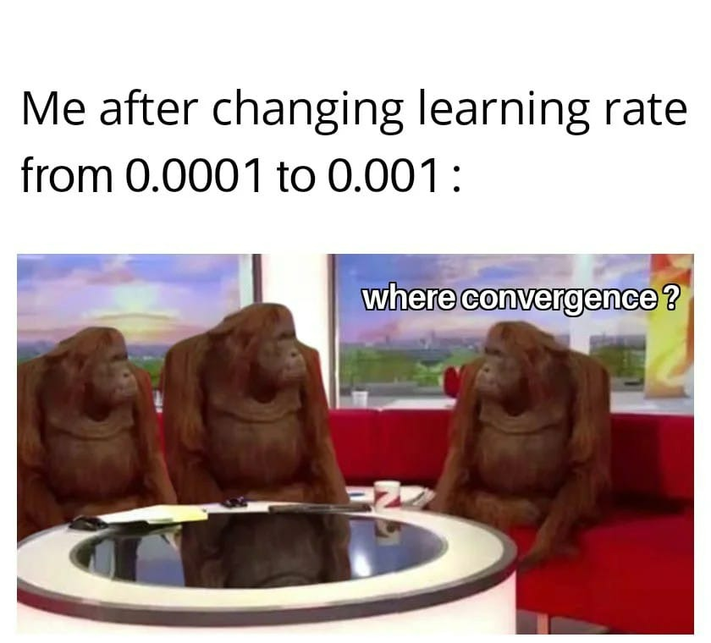

Slide 18
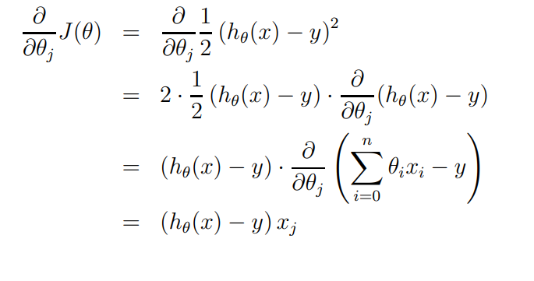
Let’s get into the Math!
(The Chain Rule :3)
Courtesy: CS229 lecture notes

Slide 19
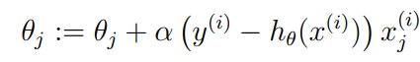
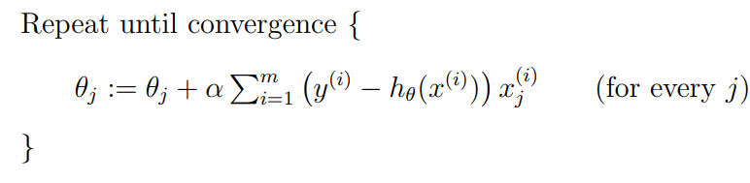
So, now we can update the parameters as:
We get this as the Final Algorithm:
Courtesy: CS229 lecture notes

Slide 20
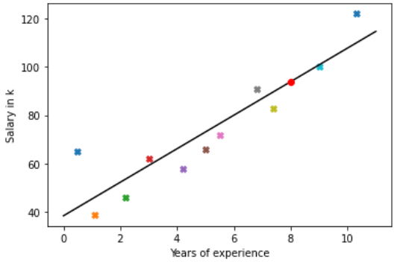
Back to the example…
(8.0,93.9)

Slide 21

Points to Remember…
We update the parameters after looking at every example in the entire training set on every step. This method is called batch gradient descent
Even though gradient descent can be susceptible to local minima in general, the optimization problem we have posed here for linear regression has only one global, and no other local, optima; thus gradient descent always converges (assuming the learning rate α is not too large) to the global minimum.

Slide 22

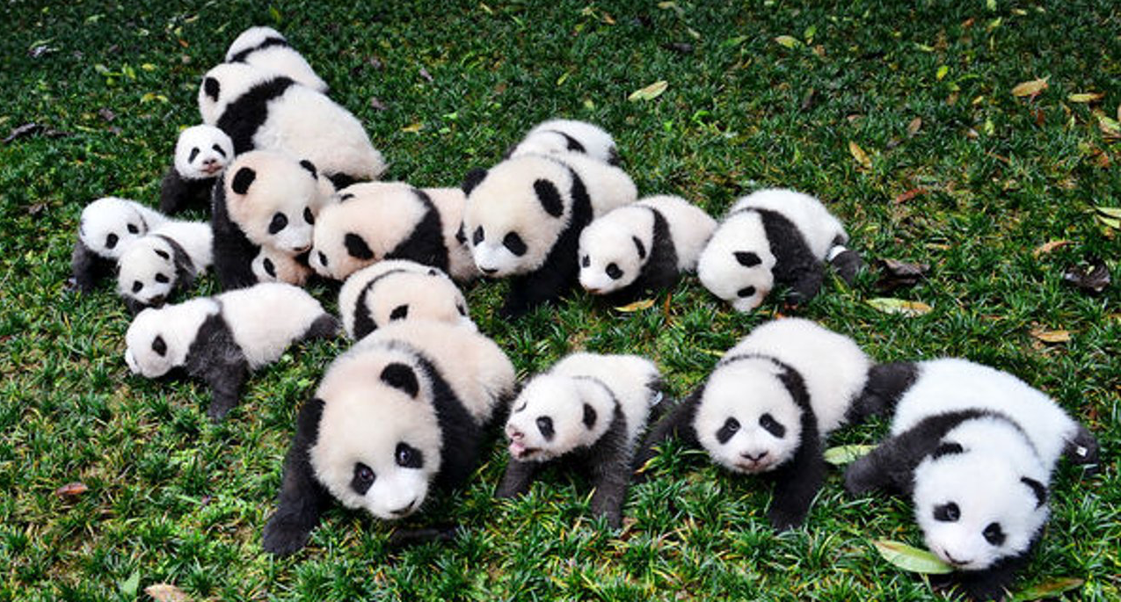

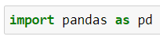
So, we have the csv file….. Now what?
Well, now we use pandas to read and analyse the data and perform preprocessing.
Pandas is a software library written for the Python programming language for data manipulation and analysis

Slide 23
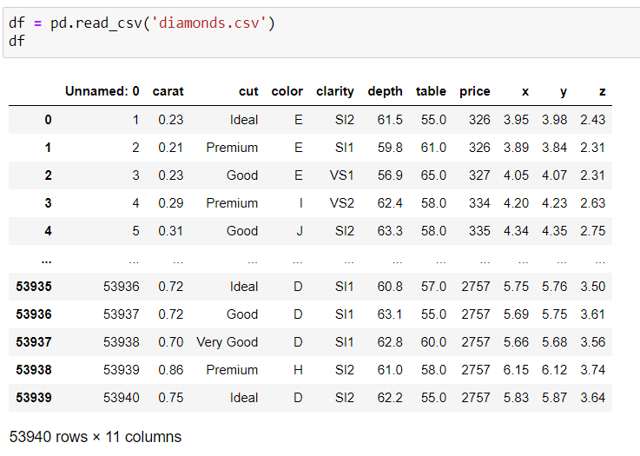
Commonly used functions from pandas
read_csv() :
read_csv() function helps read a comma-separated values (csv) file into a Pandas DataFrame. All you need to do is mention the path of the file you want it to read.

Slide 24
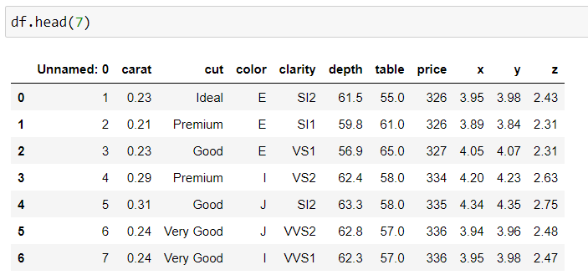
head():
head() is used to return the first n rows of a dataset. By default, df.head() will return the first 5 rows of the DataFrame. If you want more/less number of rows, you can pass an integer to the function.

Slide 25
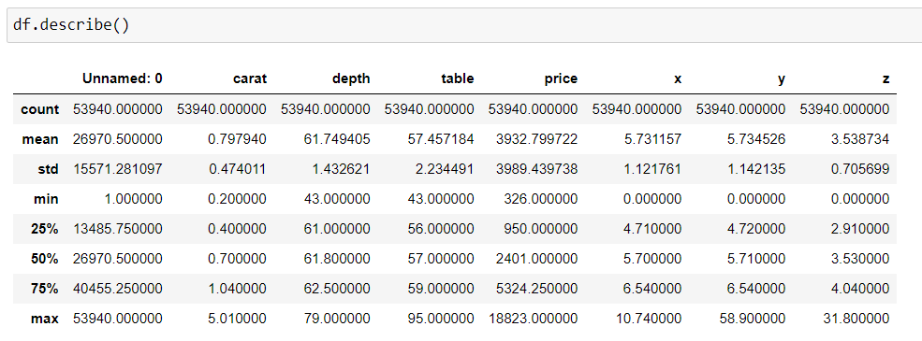
describe():
describe() is used to generate descriptive statistics of the data in a Pandas DataFrame or Series. It summarizes central tendency and dispersion of the dataset.

Slide 26
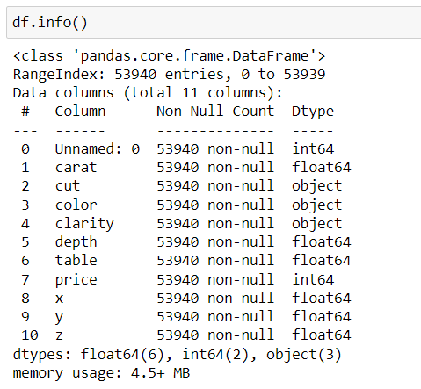
info():
This method prints information about a DataFrame including the index dtype and columns, non-null values and memory usage.

Slide 27
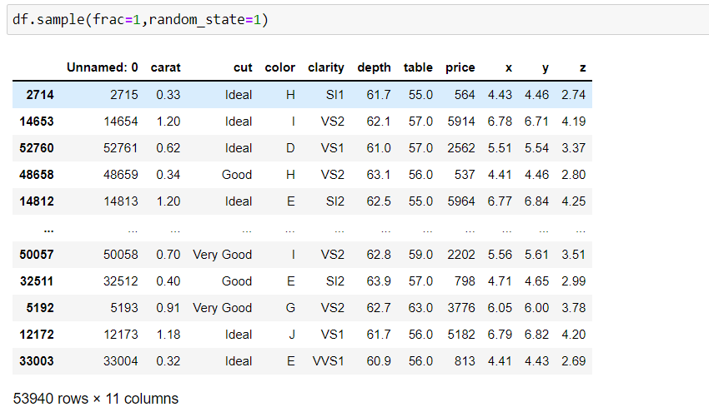
sample():
This method returns a random sample from the dataset. frac specifies the % of dataset to used. Random_state specifies the seed for random number generator. We generally give this seed so that we don’t get different samples everytime we run the code.

Slide 28
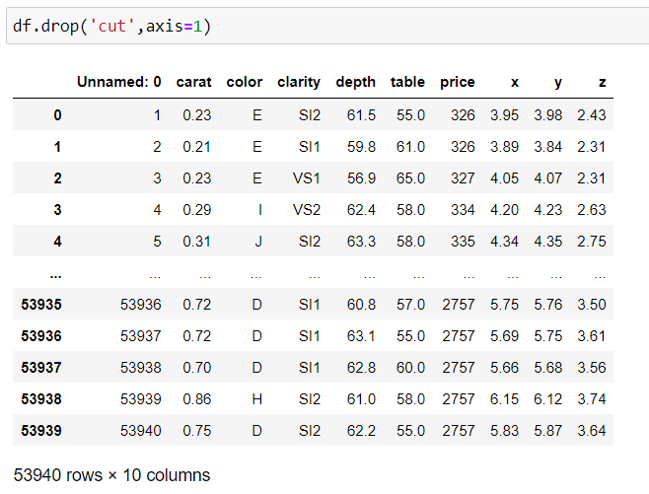
drop():
This method drops the specified column. Pass the parameter inplace=True if you want the changes to be applied on the actual dataset. axis=1 declares to look for the value to be dropped in columns.

Slide 29
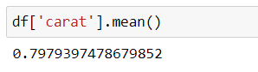
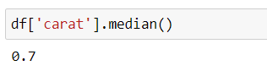
mean():
This method return the mean of the specified column in dataset.
median():
This method return the median of the specified column in dataset.
Notes:
Normalization df[‘column’] =( df[‘column’] – df[‘column’].mean() ) / df[‘column’].std()
The presence of feature value X in the formula will affect the step size of the gradient descent. The difference in ranges of features will cause different step sizes for each feature. To ensure that the gradient descent moves smoothly towards the minima and that the steps for gradient descent are updated at the same rate for all the features, we scale the data before feeding it to the model.

Slide 30
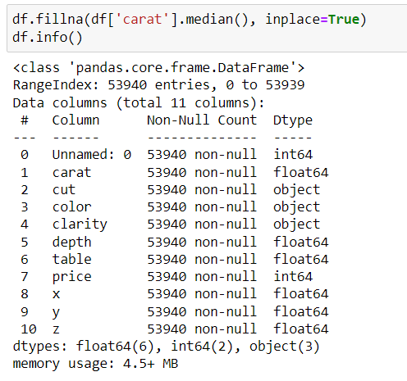
fillna():
This method fills the null values with the the user defined value.

Slide 31
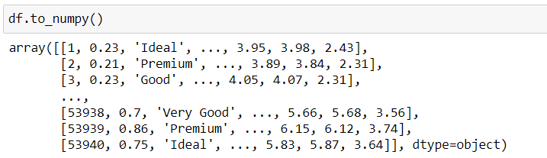
to_numpy():
This method converts the data frame into a numpy array.
(numpy? o_0)

Slide 32

Adding to your armoury - The NumPy Library!!
NumPy is a library for the Python programming language, adding support for large, multi-dimensional arrays and matrices, along with a large collection of high-level mathematical functions to operate on these arrays.

Slide 33
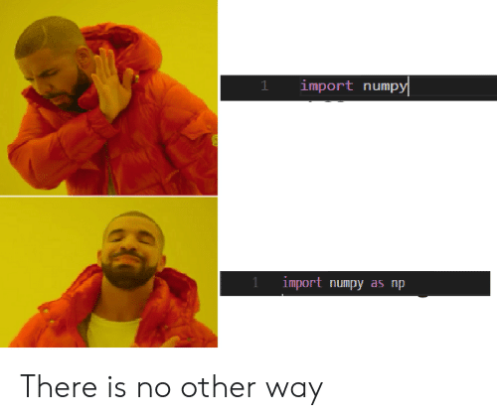

Slide 34
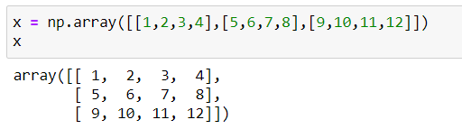
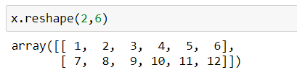
Commonly used functions from NumPy
array():
It is used to create one-dimensional or multidimensional arrays from scratch.
reshape():
It is used to reshape arrays. It returns a new array and doesn’t modify the actual array.

Slide 35
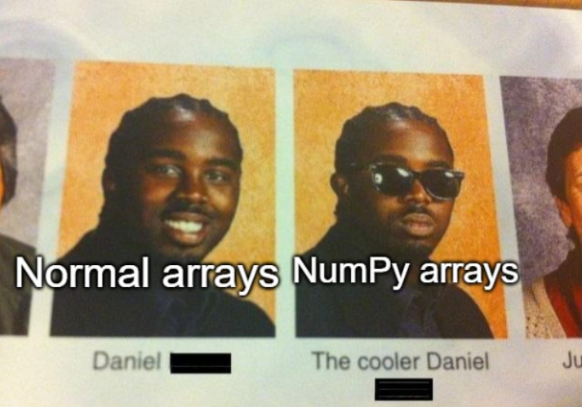

Slide 36
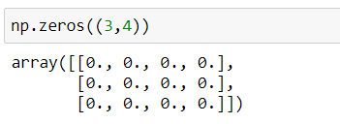
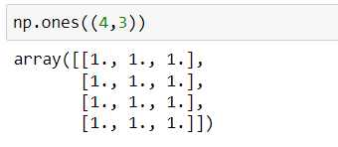
zeros:
This method returns a matrix of user defined size with all elements equal to zero.
ones:
This method returns a matrix of user defined size with all elements equal to one.

Slide 37
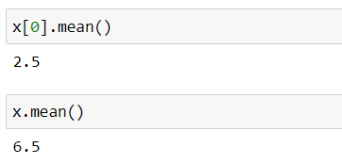
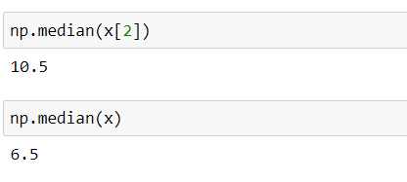
mean():
This method returns the mean of the specified array.
median():
This method return the median of the specified array.

Slide 38
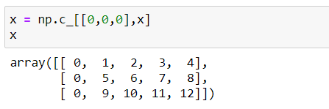
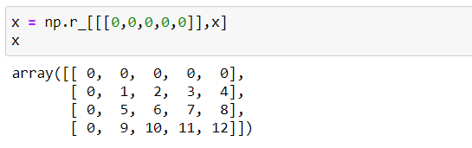
c_[]:
This method adds a given column to the beginning of a given array.
r_[]:
This method adds a given row to the beginning of a given array.

Slide 39
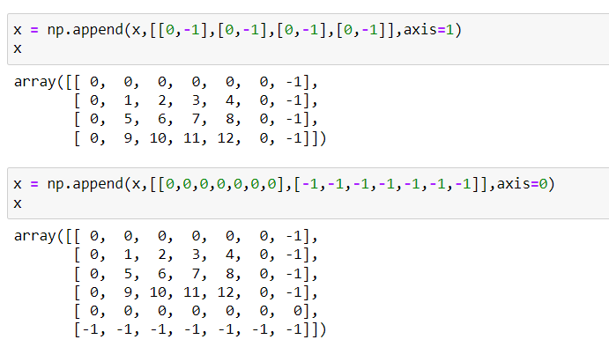
append():
This method adds given column(s) or row(s) to the end of a given array. The parameter ‘axis’ defines if the array is appended as column(s) or row(s).

Slide 40
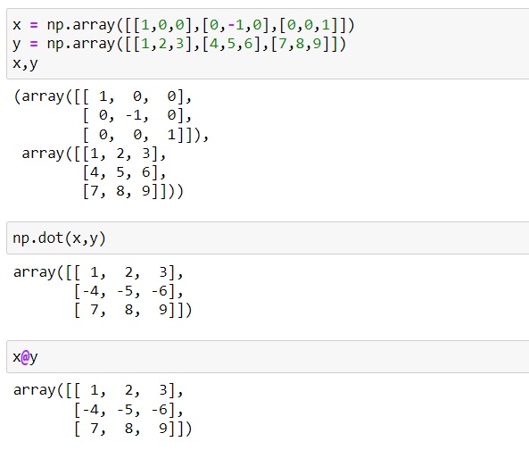
dot():
This method performs dot product of two matrices. We also can use ‘@’ operator to do the same.

Slide 41
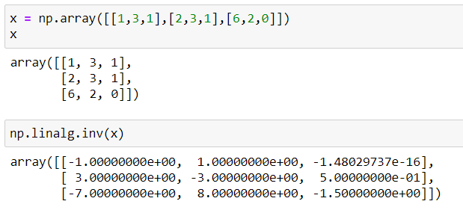
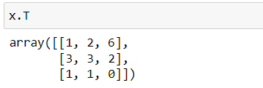
linalg.inv():
This method returns inverse of a matrix.
T():
This method returns the transpose of a matrix.

Slide 42

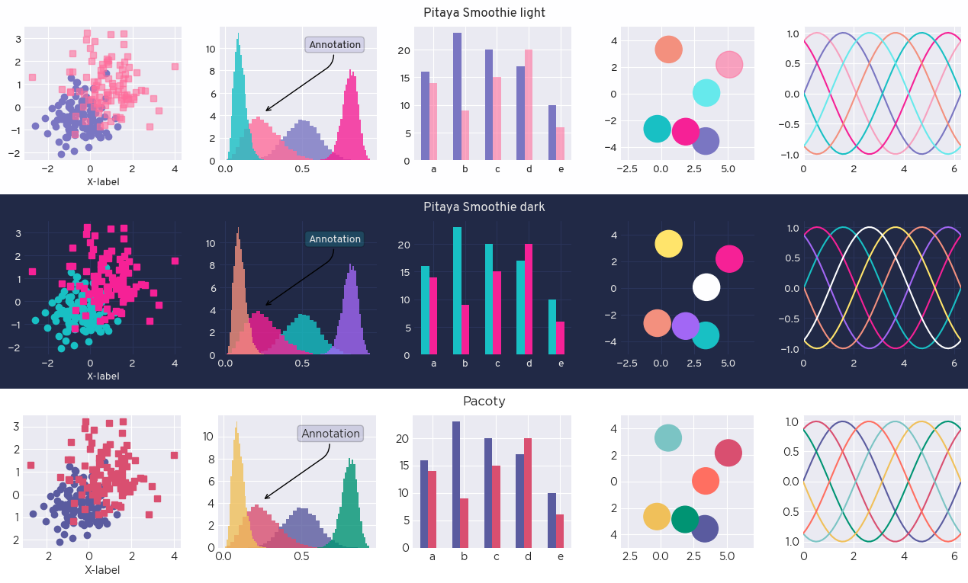
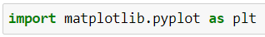
Time for some colourful plots :D
Yes! You can do such cool stuff with matplotlib! ;p

Slide 43
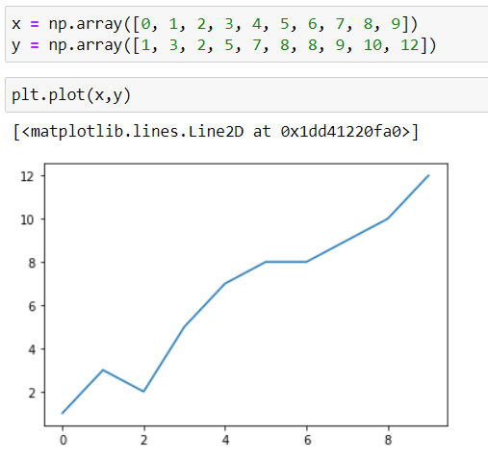
A few commonly used functions from matplotlib:
plot() :

Slide 44
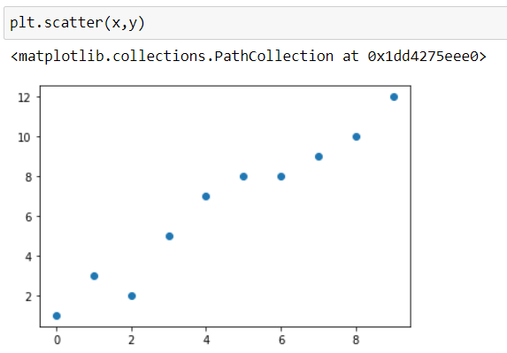
scatter():

Slide 45
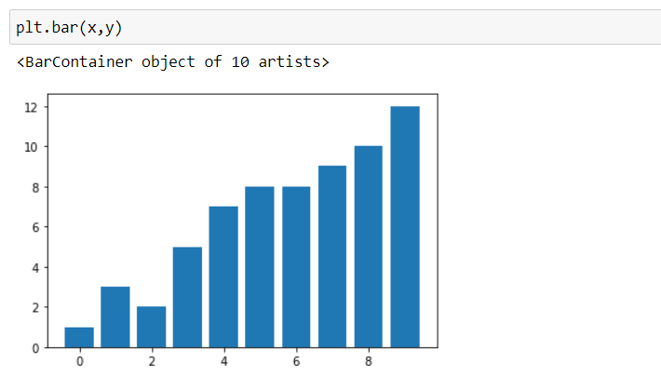
bar():

Slide 46

xlabel(), ylabel():

Slide 47

legend():

Slide 48
What if some feature is not a number?
Gender
Male
Female
Female
Male
Remarks
Nice
Good
Nice
Great
Nationality
India
USA
UK
India

Slide 49
Encoding
Encoding is a technique of converting categorical variables into numerical values so that it could be easily fitted to a machine learning model.
For example, ASCII table is character encoding.
Ordinal Encoding
Each unique category value is assigned an integer value
Gender
Male
Female
Gender
0
1
Color
Red
Green
Blue
Color
1
2
3

Slide 50
One-Hot Encoding
The categorical parameters will prepare separate columns for each label
Remarks
Nice
Good
Great
Great_rem | Nice_rem | Good_rem
0 | 1 | 0
0 | 0 | 1
1 | 0 | 0

Slide 51
Time to train our model :3

Slide 52


Slide 53


The Holy “Normal Equation”
No iterations! :D

Slide 54



Time for just a tiny bit more maths :3
Note that is a vector, and so is y. So, when we multiply one by another, it doesn't matter what the order is (as long as the dimensions work out). So, we can further simplify:
It’s derivative:

Slide 55



To minimize J, we set its derivative to be zero and obtain the normal equation.
Dimensions of is (n x n). Time complexity for inverting it will be O( ).
Hence, it is not advised to use the normal equation if no. of features is too high.
Note: Normal equation works only when m > n.

Slide 56

Thanks for coming!

Slide 57




Social Media
Follow our social media handles for regular updates
Instagram
Twitter
YouTube
WhatsApp

